Slide 1

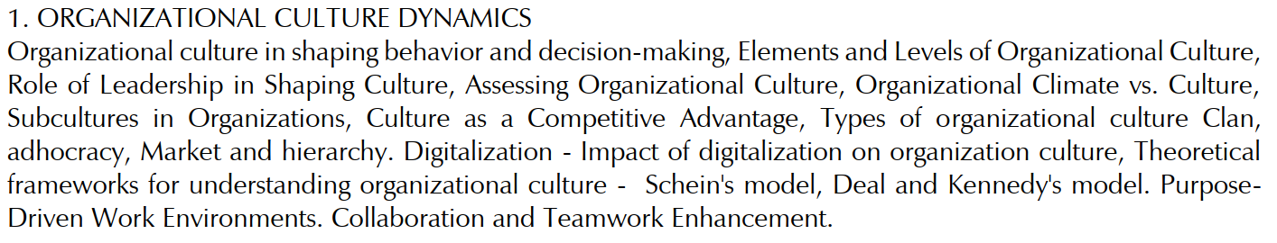
ORGANIZATIONAL CULTURE DYNAMICS

Slide 2
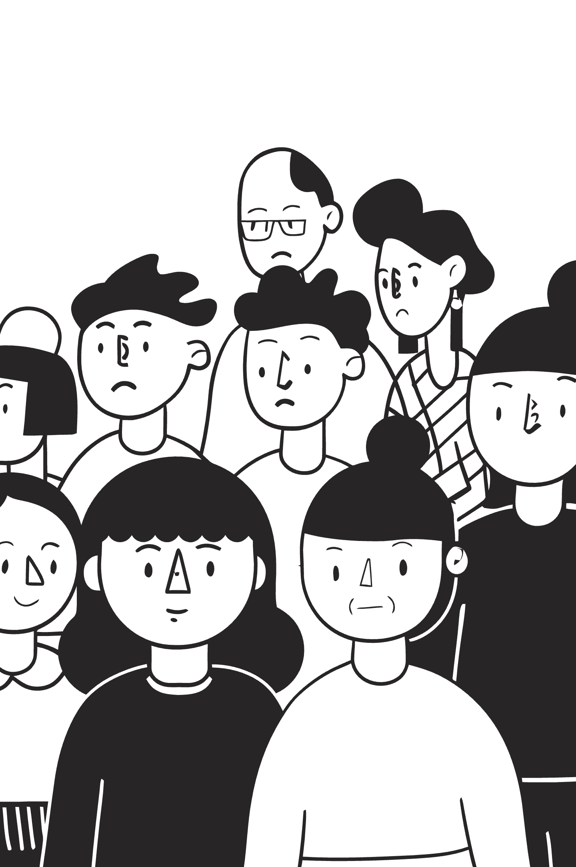
Understanding Organizational Culture
Organizational culture is a powerful force that shapes employee behavior, influences decision-making, and impacts overall company success. The dynamics of organizational culture encompass its elements, leadership's role, assessment strategies, climate differences, subcultures, types, the impact of digitalization, theoretical frameworks, and how it drives collaboration and purpose-driven work.
Key Influences
Core Components
Employee behavior
Cultural elements
Decision-making processes
Leadership's role
Overall company success
Assessment strategies
Modern Factors
Digitalization impact
Theoretical frameworks
Collaboration drivers
Notes:
Lecture Notes: Understanding Organizational Culture
Introduction Let’s begin with a simple idea: every organization, whether a small startup or a global corporation, has a culture. Organizational culture is not something written only in handbooks or policies. It’s the shared values, beliefs, and ways of working that guide people—often unconsciously. Culture is powerful because it shapes how employees behave, how leaders make decisions, and even how the company succeeds or fails in the long run.
Why Organizational Culture Matters Think of culture as the “personality” of an organization. Just as our personality influences how we respond to situations, organizational culture guides how people in a company respond to challenges, opportunities, or even crises.
It influences employee behavior: whether employees collaborate or compete, whether they take initiative or wait for orders.
It shapes decision-making: some cultures encourage quick risk-taking, while others favor caution and hierarchy.
And importantly, it impacts the overall success of the company: strong, adaptive cultures often outperform weak or fragmented ones.

Slide 3

Culture's Influence on Actions and Choices
Organizational culture provides shared values, norms, and expected behaviors that guide how employees act and make decisions. This impacts everything from daily workflow to long-term strategic moves, shaping crucial aspects of organizational life.
Risk Tolerance
Transparency
Defines how individuals and teams perceive and manage risks, encouraging or discouraging innovation.
Influences the degree of openness in communication, decision processes, and information sharing.
Ethical Conduct
Collaboration
Establishes the moral compass for all actions, ensuring integrity and responsible behavior.
Fosters an environment that promotes teamwork, shared goals, and cross-functional cooperation.
Notes:
Culture's Influence on Actions and Choices
Overview: Organizational culture significantly influences how individuals and teams act and make decisions in a workplace. It provides shared values, norms, and expected behaviors that guide employees' daily actions and strategic moves, thereby shaping key aspects of organizational life.
1. Risk Tolerance
Definition: Risk tolerance refers to how individuals and teams perceive and manage risks within an organization.
Impact: High risk tolerance may encourage innovation, new ideas, and creative problem-solving. Low risk tolerance may discourage experimentation and limit growth.
Key Points:
Helps in determining whether an organization is more conservative or open to taking risks.
A culture with higher risk tolerance typically supports pioneering efforts and disruptive innovations.
2. Transparency
Definition: Transparency in an organization refers to the degree of openness in communication, decision processes, and information sharing.
Impact: A transparent culture fosters trust, encourages open dialogue, and ensures everyone is on the same page.
Key Points:
Transparency promotes ethical practices and ensures fairness in decision-making.
It helps in breaking down silos and ensuring that all employees are informed and aligned with the organization's goals.
3. Ethical Conduct
Definition: Ethical conduct establishes the moral framework that guides how actions are taken in an organization, ensuring integrity and responsible behavior.
Impact: A strong ethical culture builds a foundation of trust, enhances reputation, and promotes sustainable business practices.
Key Points:
Encourages responsible behavior among employees, ensuring decisions align with moral and legal standards.
It acts as the backbone of organizational reputation and ensures compliance with regulations.
4. Collaboration
Definition: Collaboration fosters an environment that promotes teamwork, shared goals, and cross-functional cooperation.
Impact: Collaborative cultures improve problem-solving, knowledge sharing, and efficiency within teams.
Key Points:
Encourages employees to work together towards common objectives, often leading to better innovation and productivity.
Strong collaboration helps create synergies and reduces barriers between different departments.
Conclusion:
Culture plays a pivotal role in shaping actions and decisions within an organization. It not only impacts how individuals approach daily tasks but also how they align with long-term strategies, organizational goals, and ethical standards. The four areas of risk tolerance, transparency, ethical conduct, and collaboration are integral in building a strong, adaptive, and responsible organizational culture.

Slide 4
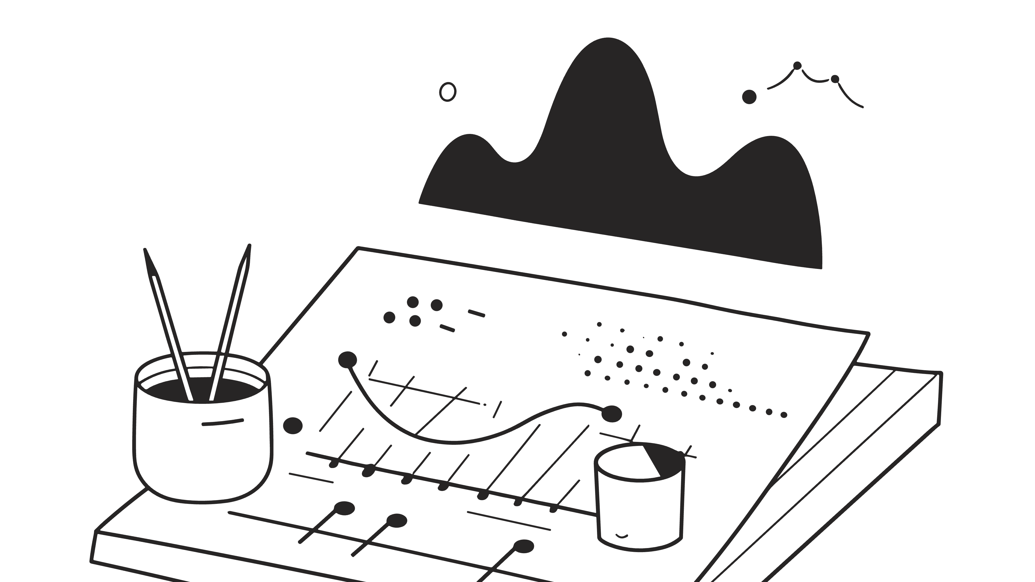



Elements and Levels of Organizational Culture
Organizational culture is multifaceted, comprising observable elements and deeper, often unconscious, layers that shape behavior. Edgar Schein's model offers a classic framework for understanding these distinct levels.
Artifacts
1
Visible signs like dress code, office layout, and communication styles.
Espoused Values
2
Stated goals, philosophies, and policies that guide behavior.
Underlying Assumptions
3
Deep-rooted, unconscious beliefs that are taken for granted and influence perceptions.
These layers interact to create a unique cultural identity, impacting everything from daily interactions
to strategic decisions.
Notes:
Elements and Levels of Organizational Culture
Overview: Organizational culture is multifaceted, consisting of observable elements as well as deeper, often unconscious layers that influence behavior. Edgar Schein’s model is commonly used to understand these levels of culture and how they shape actions, interactions, and decisions within organizations.
1. Artifacts (Level 1)
Definition: Artifacts are the visible signs of an organization’s culture, which can be easily observed.
Examples:
Dress code
Office layout
Communication styles
Physical symbols and structures
Impact: Artifacts reflect the outward expression of culture, allowing new members to get a sense of the organization’s cultural norms. However, they may not provide deep insight into the underlying values or assumptions.
2. Espoused Values (Level 2)
Definition: Espoused values refer to the stated goals, philosophies, and policies that guide behavior within an organization.
Examples:
Mission and vision statements
Organizational policies
Core values (e.g., integrity, collaboration)
Impact: Espoused values provide a framework for behavior and decisions within the organization. They influence how employees perceive their roles and responsibilities, and how they are expected to perform in alignment with the organization’s goals.
3. Underlying Assumptions (Level 3)
Definition: Underlying assumptions are deep-rooted, unconscious beliefs that are taken for granted and shape how members of the organization view their work and environment.
Examples:
Assumptions about human nature (e.g., whether people are inherently trustworthy or need strict supervision)
Beliefs about organizational success (e.g., innovation versus tradition)
Views on power and decision-making
Impact: These assumptions are the most powerful elements of culture. They often go unnoticed because they are so ingrained, but they significantly influence how decisions are made and how people interact with each other.
Conclusion:
Edgar Schein’s model shows that organizational culture is made up of visible artifacts, espoused values, and deeply held underlying assumptions. These layers work together to create a unique cultural identity that impacts everything from daily interactions to strategic decision-making. Understanding these elements can help leaders shape and navigate an organization’s culture effectively.

Slide 5
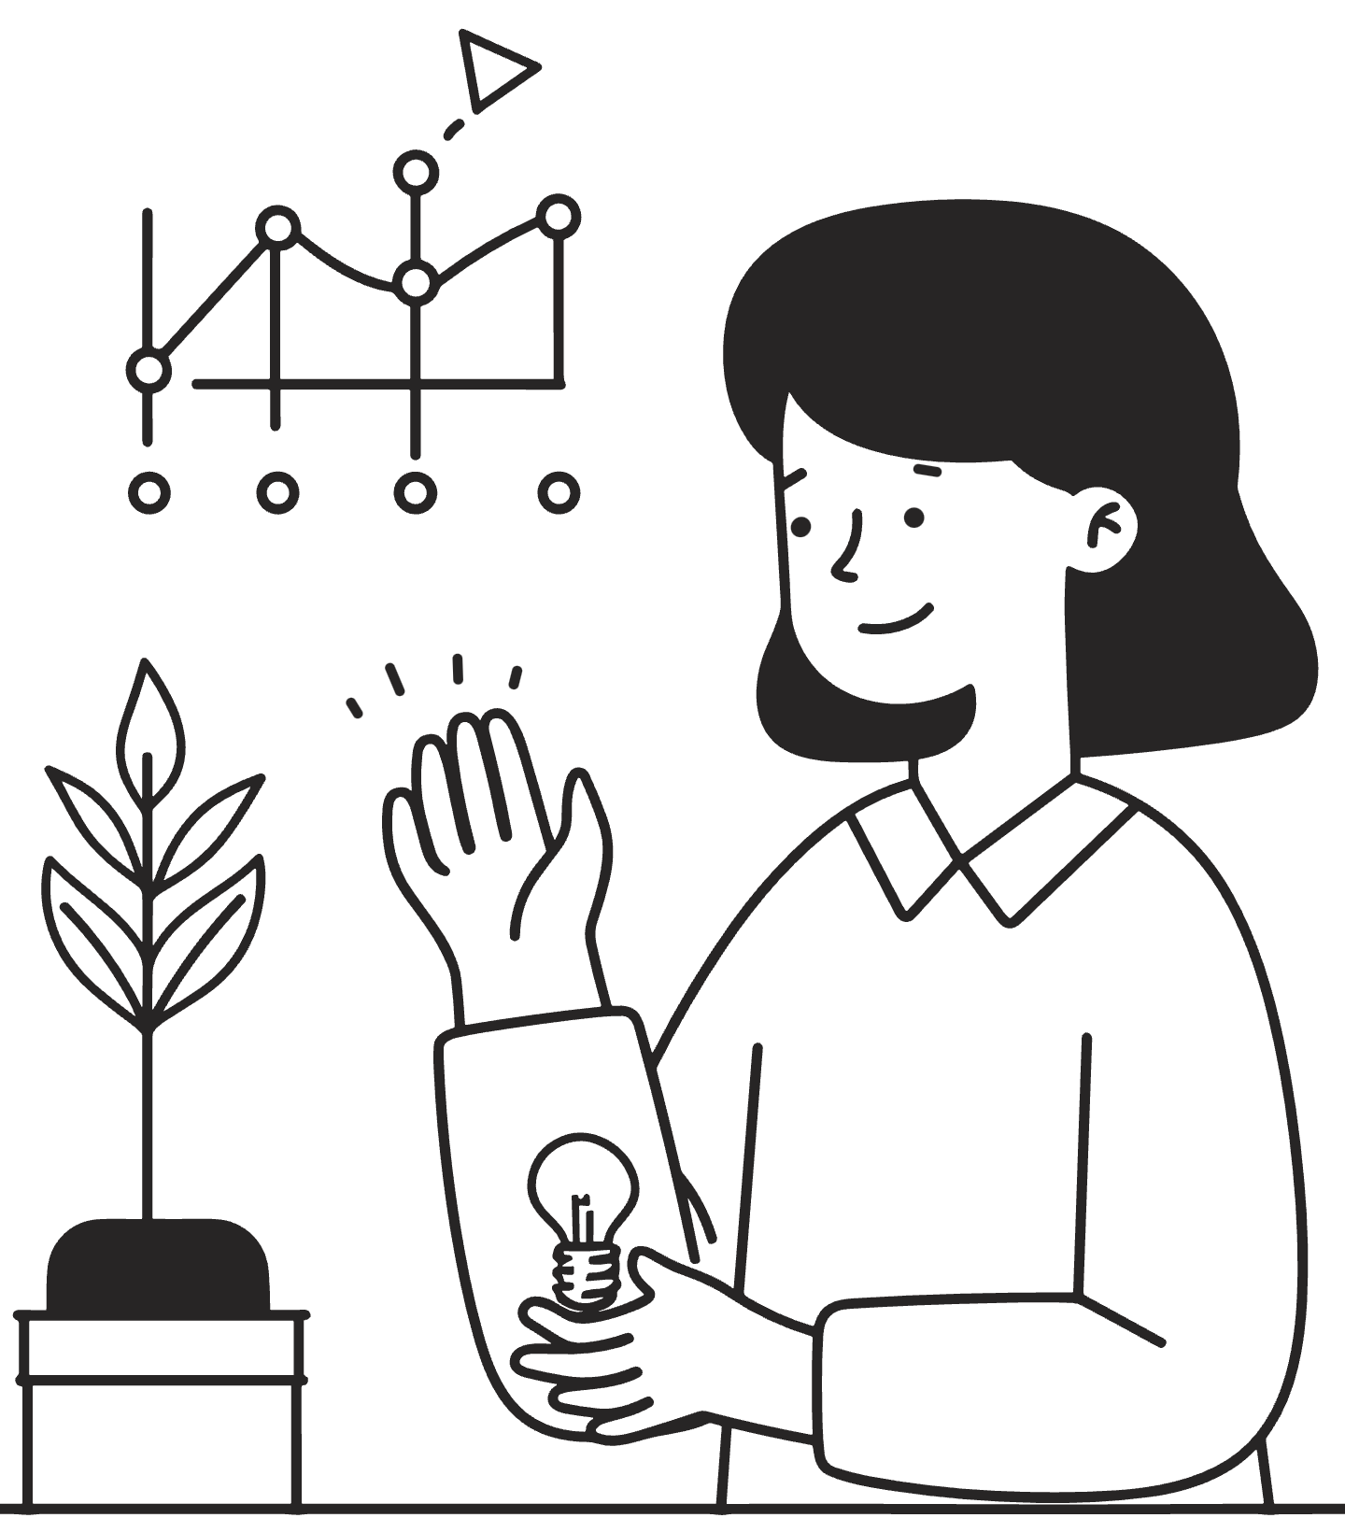


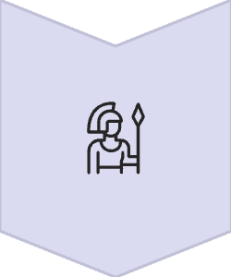

Leadership’s Role in Shaping Culture
Leaders are central - establishing, communicating, and modeling organizational values. Their actions set the tone, reinforce desired behaviors, and drive cultural change during digital transformation or organizational restructuring.
Establish & Communicate
Define and articulate the core values and mission.
Model Behaviors
Embody desired cultural traits through daily actions.
Reinforce Behaviors
Encourage and reward actions aligned with the culture.
https://www.youtube.com/watch?v=jc94qmUG1hw
Drive Change
Guide the organization through periods of significant
cultural evolution.
Notes:
Overview of Leadership’s Role
Leaders are responsible for shaping, communicating, and demonstrating the organization’s values and culture. Their actions set the direction for the team, reinforce expected behaviors, and guide the organization especially during major changes like digital transformation or restructuring.
Four Key Leadership Actions
Establish & Communicate
Leaders must define and clearly express the organization’s core values and mission. This sets a foundation for what is important and guides everyone’s behavior.
Model Behaviors
Leaders should personally demonstrate the cultural traits the organization desires through their everyday actions. When leaders act according to the values, others are likely to follow.
Reinforce Behaviors
Leaders must encourage and reward actions that match the desired culture. Recognizing and rewarding good examples ensures these behaviors are repeated and become normal.
Drive Change
Leaders guide the organization through times of significant change. They help everyone adapt as the culture evolves—especially during important transitions.
How to Explain to Students
Leaders influence culture by showing what is important and acting as role models.
They make values clear, demonstrate them, reward behaviors that fit the culture, and guide everyone through changes.
Each step connects leadership directly to the everyday experience of organizational culture, showing how leaders can positively shape what their organization stands for and how people work together
Overview: Leaders play a central role in shaping and maintaining organizational culture. Their actions, values, and behavior set the tone for the rest of the organization. As culture evolves, especially during periods of digital transformation or organizational restructuring, leaders guide and influence these changes.
1. Establish & Communicate
Definition: Leaders define and articulate the core values and mission of the organization.
Impact: By clearly establishing values and communicating them effectively, leaders set the foundation for the culture. They ensure that everyone in the organization understands the organization’s direction, purpose, and goals.
Key Points:
Clear communication of values creates alignment across the organization.
Employees are more likely to adopt these values when they are clearly articulated and visible in day-to-day activities.
2. Model Behaviors
Definition: Leaders embody cultural traits through their daily actions.
Impact: Leaders serve as role models for the behaviors they want to see in their teams. If a leader consistently demonstrates cultural traits such as collaboration, innovation, or ethical behavior, it encourages employees to follow suit.
Key Points:
Leaders must lead by example, as their actions significantly influence the rest of the organization.
Modeling desired behaviors is key in instilling these values at all levels of the organization.
3. Reinforce Behaviors
Definition: Leaders encourage and reward actions that align with the desired culture.
Impact: When leaders recognize and reward behaviors that align with organizational values, it reinforces the culture. This can include promotions, recognition programs, or other forms of acknowledgment.
Key Points:
Reinforcement ensures that desired behaviors become ingrained in the organization’s culture.
Positive reinforcement leads to greater motivation and adherence to cultural values across the workforce.
4. Drive Change
Definition: Leaders guide the organization through periods of significant cultural evolution.
Impact: During periods of change, such as digital transformations or organizational restructuring, leaders must steer the organization through the cultural shifts required. This includes adapting to new ways of working, communication styles, and overall business practices.
Key Points:
Effective leadership is critical to managing change in organizational culture.
Leaders must ensure that cultural shifts align with new business strategies and technologies.
Conclusion:
Leadership is pivotal in shaping and guiding organizational culture. By establishing clear values, modeling desired behaviors, reinforcing actions that align with culture, and driving change, leaders influence the culture at all levels. This guidance helps the organization adapt, thrive, and stay aligned with its mission, even during times of transformation.

Slide 6
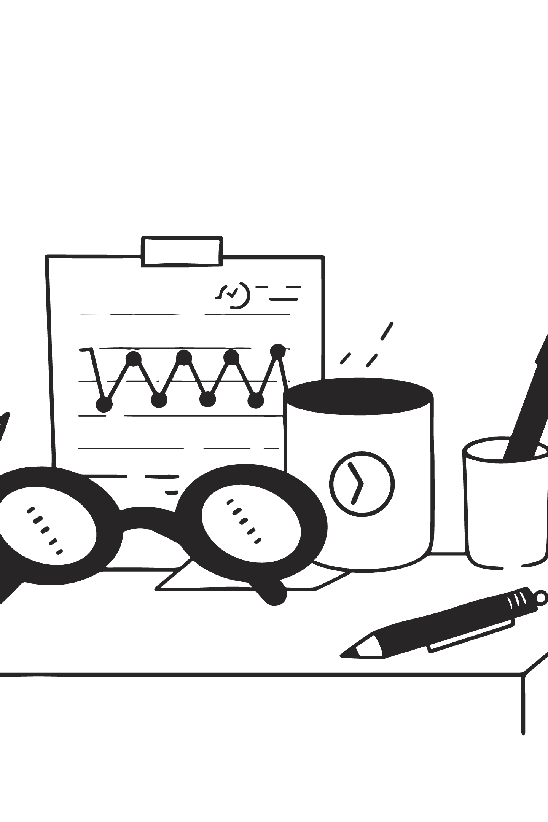




Assessing Organizational Culture
Organizational culture is multifaceted and can be systematically assessed to understand its current state and identify areas for development. Diverse methods provide a holistic view.
Employee Surveys
Collect quantitative data on perceptions, values, and attitudes across the organization.
Focus Groups & Interviews
Gather qualitative insights, delving deeper into shared experiences and underlying beliefs.
Behavioral Observation
Directly observe daily interactions, communication patterns, and decision-making processes.
Artifacts & Rituals
Analyze visible symbols, stories, ceremonies, and physical environment that reflect culture.
Specialized tools like the Organizational Culture Assessment Instrument (OCAI) can help map cultural types and strengths, providing a framework for strategic cultural initiatives.
Notes:
Assessing Organizational Culture
Overview: Organizational culture is multifaceted and can be systematically assessed to understand its current state and identify areas for development. Using diverse methods allows for a holistic view of the organization’s cultural dynamics, helping to shape more effective strategies for growth and improvement.
1. Employee Surveys
Definition: Collect quantitative data on perceptions, values, and attitudes across the organization.
Impact: Employee surveys provide an efficient way to gauge the overall sentiment of the workforce, collecting feedback on how employees view the organization’s culture. The data can highlight strengths and areas that need attention.
Key Points:
Helps in understanding employee satisfaction and alignment with organizational values.
The survey results can identify gaps between what leaders believe the culture to be and how employees perceive it.
2. Focus Groups & Interviews
Definition: Gather qualitative insights by engaging employees in deeper discussions about their shared experiences and underlying beliefs.
Impact: Focus groups and interviews provide a more personal, in-depth understanding of the culture. They reveal the nuanced and less tangible aspects of organizational life, such as unspoken norms and values.
Key Points:
Encourages open dialogue and can uncover the "why" behind certain behaviors.
This method is more flexible, allowing for exploration of specific topics that may arise during discussions.
3. Behavioral Observation
Definition: Directly observe daily interactions, communication patterns, and decision-making processes.
Impact: Observing behavior in action offers real-time insight into how the culture manifests in everyday activities. This method highlights the actual versus the intended culture, revealing areas where actions may diverge from organizational values.
Key Points:
Provides a firsthand look at the dynamics of team collaboration and leadership styles.
This method can show whether employees are acting in alignment with cultural expectations.
4. Artifacts & Rituals
Definition: Analyze visible symbols, stories, ceremonies, and physical environments that reflect culture.
Impact: Artifacts and rituals often symbolize deeper cultural values, providing tangible evidence of an organization's culture. Understanding these elements can help identify the symbolic importance placed on certain practices or values.
Key Points:
Physical elements like office design or employee traditions (e.g., company celebrations) reveal much about the culture.
Rituals can indicate how cultural values are reinforced through everyday practices.
Conclusion:
Assessing organizational culture involves a combination of methods—surveys, focus groups, behavioral observation, and analysis of artifacts and rituals—to develop a comprehensive understanding of the current culture. These insights are essential for identifying opportunities for development and for aligning the organization’s culture with its strategic goals.

Slide 7
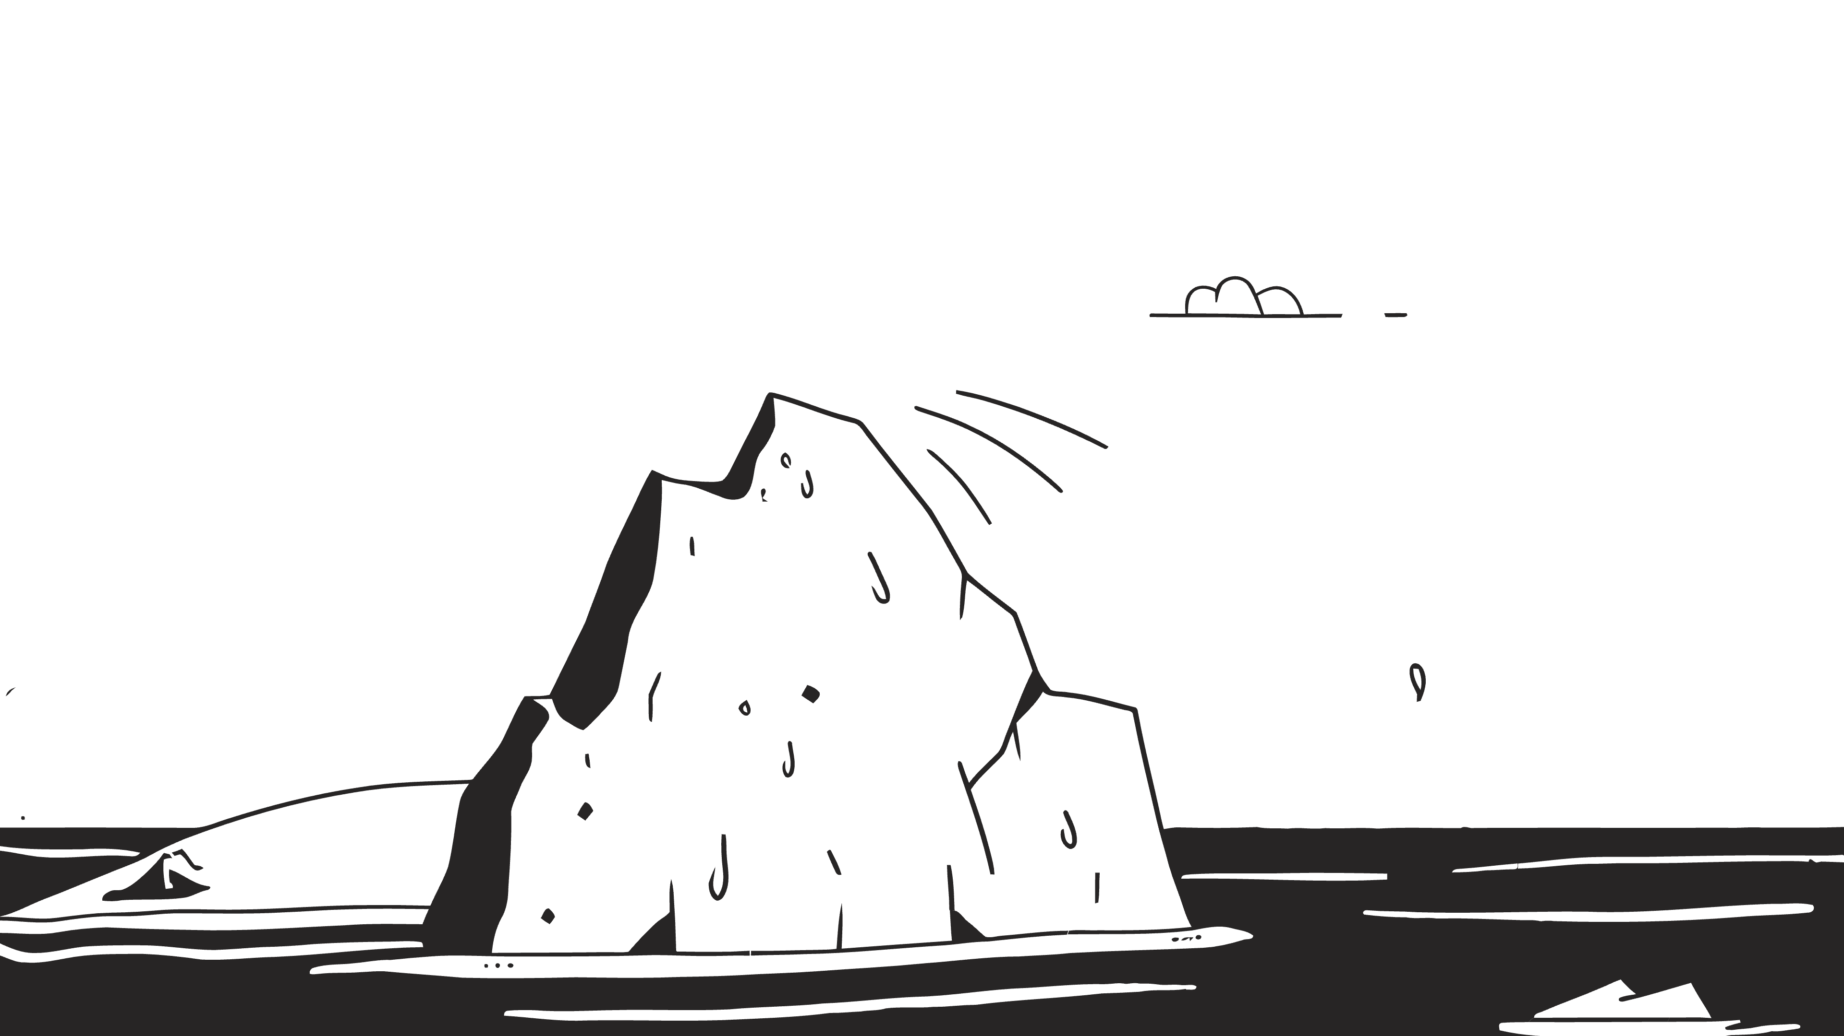
Organizational Climate vs. Culture
While often used interchangeably, organizational climate and culture are distinct concepts that profoundly influence a workplace. Understanding their differences is key to effective management and sustainable change.
Organizational Climate
Organizational Culture
Climate describes the current atmosphere, perceptions, and feelings about the work environment. It's often a snapshot of how employees feel right now, influenced by current leadership, policies, and immediate events.
Culture is much deeper-a system of shared meanings, values, and underlying assumptions that are more long-lasting and influential over time. It shapes how people think, behave, and make decisions within the organization. (trust, support, fairness, etc.).
Think of it as the weather-changeable and reflecting immediate conditions.
Consider it the climate-stable patterns over a long period, defining the organizational ecosystem.
Notes:
Organizational Culture in Indian Companies
Infosys
Culture: Built around ethics, transparency, and respect for stakeholders. Narayana Murthy emphasized integrity as the company’s DNA.
Example: Consistent focus on corporate governance and trust with clients.
Tata Group
Culture: Philanthropy, nation-building, and “leadership with trust.”
Example: Social responsibility is deeply embedded (e.g., Tata Trusts funding education, health, and rural development).
Wipro
Culture: Rooted in values of discipline and customer-centricity.
Example: “Spirit of Wipro” values (intensity to win, act with sensitivity, unyielding integrity).
Amul (Gujarat Cooperative Milk Marketing Federation)
Culture: Cooperative, community-driven, and farmer-first.
Example: The entire brand is built around empowering farmers and “Taste of India.”
Organizational Climate in Indian Companies
Flipkart
Climate: Fast-paced, high-pressure, startup-style work environment.
Example: During festive sales, employees often describe an “all-hands-on-deck” climate of energy and intensity.
Infosys (again, but climate angle)
Climate: Post-2017 leadership changes brought uncertainty and cautiousness, though culture of ethics remained intact.
HCL Technologies
Climate: Employee-first policy fostered openness and empowerment.
Example: “Employees First, Customers Second” initiative changed the workplace climate toward inclusivity and accountability.
IndiGo Airlines
Climate: Highly efficiency-focused, sometimes perceived as strict and disciplined.
Example: Employees experience a climate of tight schedules and performance-driven routines.
Quick Exam Tip (Indian Context)
Culture: Long-term DNA → Tata’s social responsibility, Infosys’ ethics, Amul’s cooperative spirit.
Climate: Current mood → Flipkart’s festival rush, HCL’s empowerment era, IndiGo’s high-pressure environment.

Slide 8
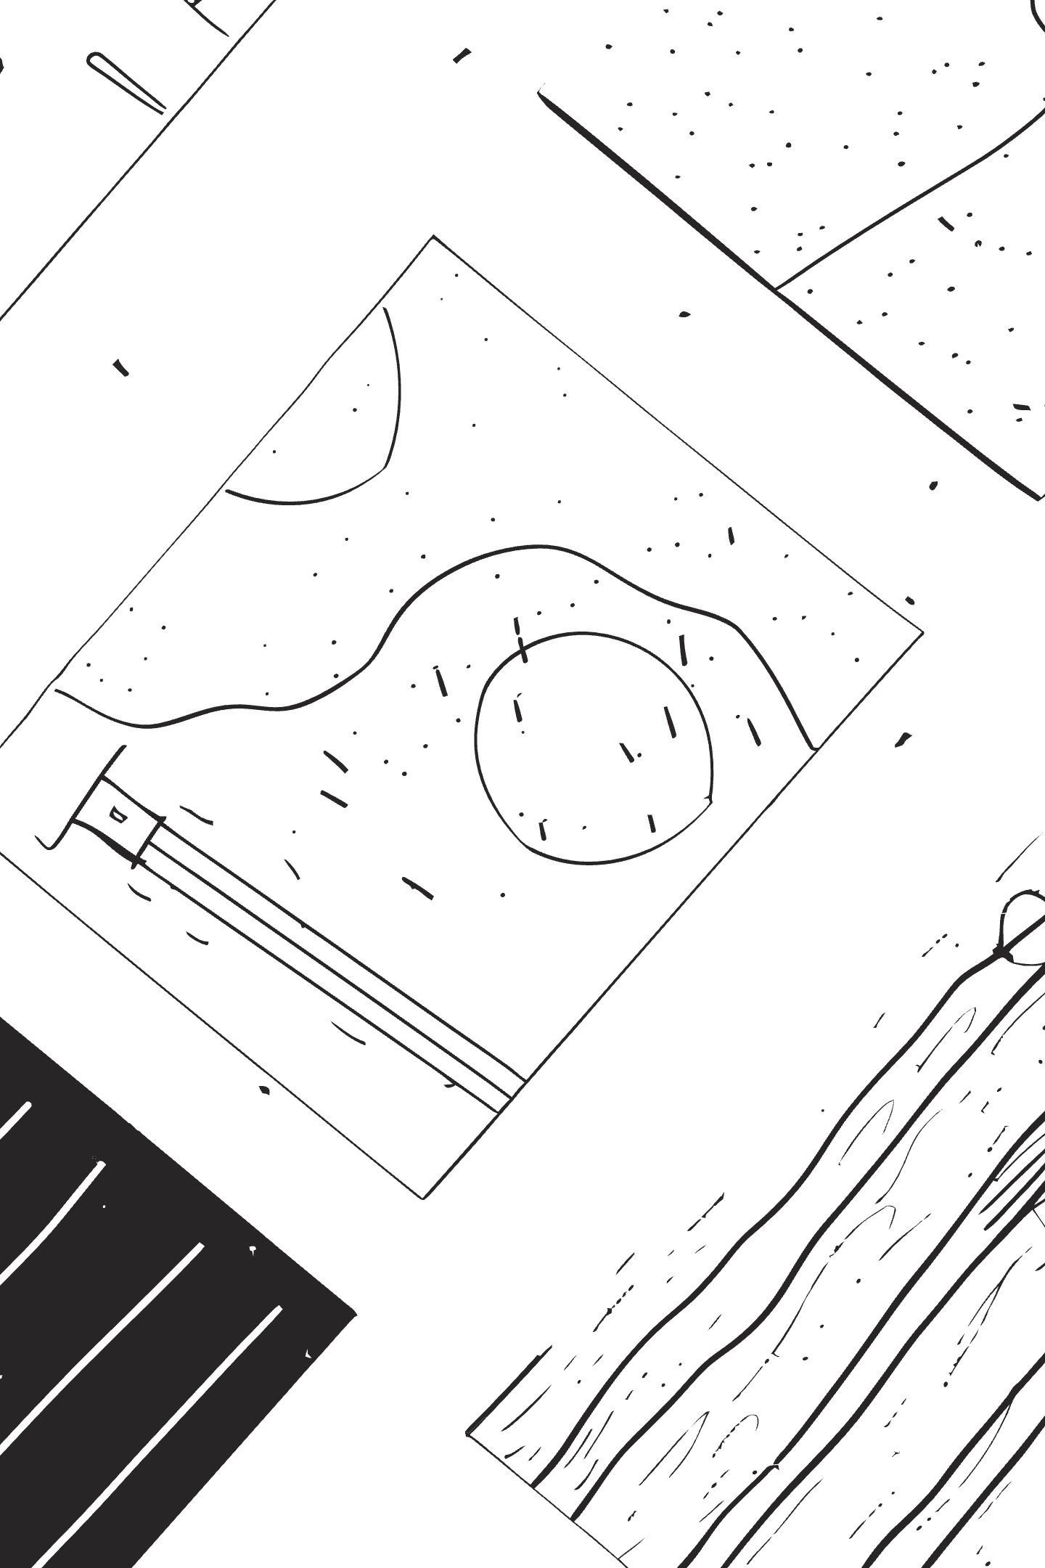
Organizational Climate vs. Culture: The Deal & Kennedy Framework
While often conflated, organizational climate and culture are distinct yet interconnected. Terrence Deal and Allan Kennedy's work provides a classic lens through which to understand their nuances and the profound impact each has on an organization's dynamics.
Climate: The "Atmosphere"
Reflects the current, often temporary, mood and perceptions of employees regarding their work environment, policies, and practices. It's how people feel about where they work right now, influenced by leadership's immediate actions.
Tangible: Can be measured through surveys about job satisfaction, morale, and immediate leadership effectiveness.
Changeable: Can shift relatively quickly in response to events or management decisions.
Culture: The "Personality"
Represents the deeper, more enduring system of shared values, beliefs, assumptions, and norms that guide behavior. It's the ingrained way things are done around here, developed over time through shared experiences.
Abstract: Less visible, rooted in collective history and often unconscious.
Stable: Resistant to rapid change, requiring significant effort to transform.
Deal & Kennedy emphasize that while climate is observable and responsive, it's culture that truly defines an organization's long-term identity and resilience.
Notes:
Organizational Climate vs. Culture: The Deal & Kennedy Framework
Overview: Terrence Deal and Allan Kennedy’s framework on organizational climate and culture explores how these concepts are interconnected. Their model helps understand the profound impact both have on an organization's performance and long-term resilience.
Organizational Climate: The "Atmosphere"
Definition: Climate reflects the current, short-term mood, perceptions, and feelings about the work environment, policies, and leadership.
Characteristics:
Tangibles: Climate is measurable through employee satisfaction, morale surveys, and immediate reactions to changes in leadership or events.
Changeable: Climate can shift quickly, often as a reaction to leadership changes, management decisions, or external events.
Impact: It reflects the immediate environment that employees are experiencing and can fluctuate rapidly. Changes in leadership, work policies, or even external events can cause significant shifts in climate.
Organizational Culture: The "Personality"
Definition: Culture represents the deeper, more enduring system of shared values, beliefs, assumptions, and norms that drive behavior within an organization.
Characteristics:
Abstract: Unlike climate, culture is harder to measure. It is deeply rooted in the collective history and unconscious assumptions of the organization.
Resistant to Change: Organizational culture is deeply ingrained and resistant to transformation, often evolving slowly over time.
Impact: Culture shapes how people think, behave, and make decisions. It is the organizational "personality" that influences long-term strategies and employee interactions. While climate can change rapidly, culture requires a significant shift to transform.
Key Insights from Deal & Kennedy
Deal & Kennedy emphasize that while organizational climate is observable and responsive to immediate factors, culture defines the long-term identity of an organization.
The organizational climate reacts to short-term leadership decisions, but the culture defines how the organization will sustain itself over time and how it will adapt to change.
Conclusion:
Climate: Think of it as the weather—it reflects the short-term conditions of the organization.
Culture: Consider it as the personality—it forms the foundation of the organization and shapes its identity over the long term.
By understanding both, organizations can better manage their current atmosphere while building a resilient culture for the future.

Slide 9

Organizational Culture Overview
Understanding the complex dynamics of organizational culture is essential for effective management and leadership. Organizations often contain multiple subcultures that influence how work gets done and how employees relate to the broader company mission.

Slide 10
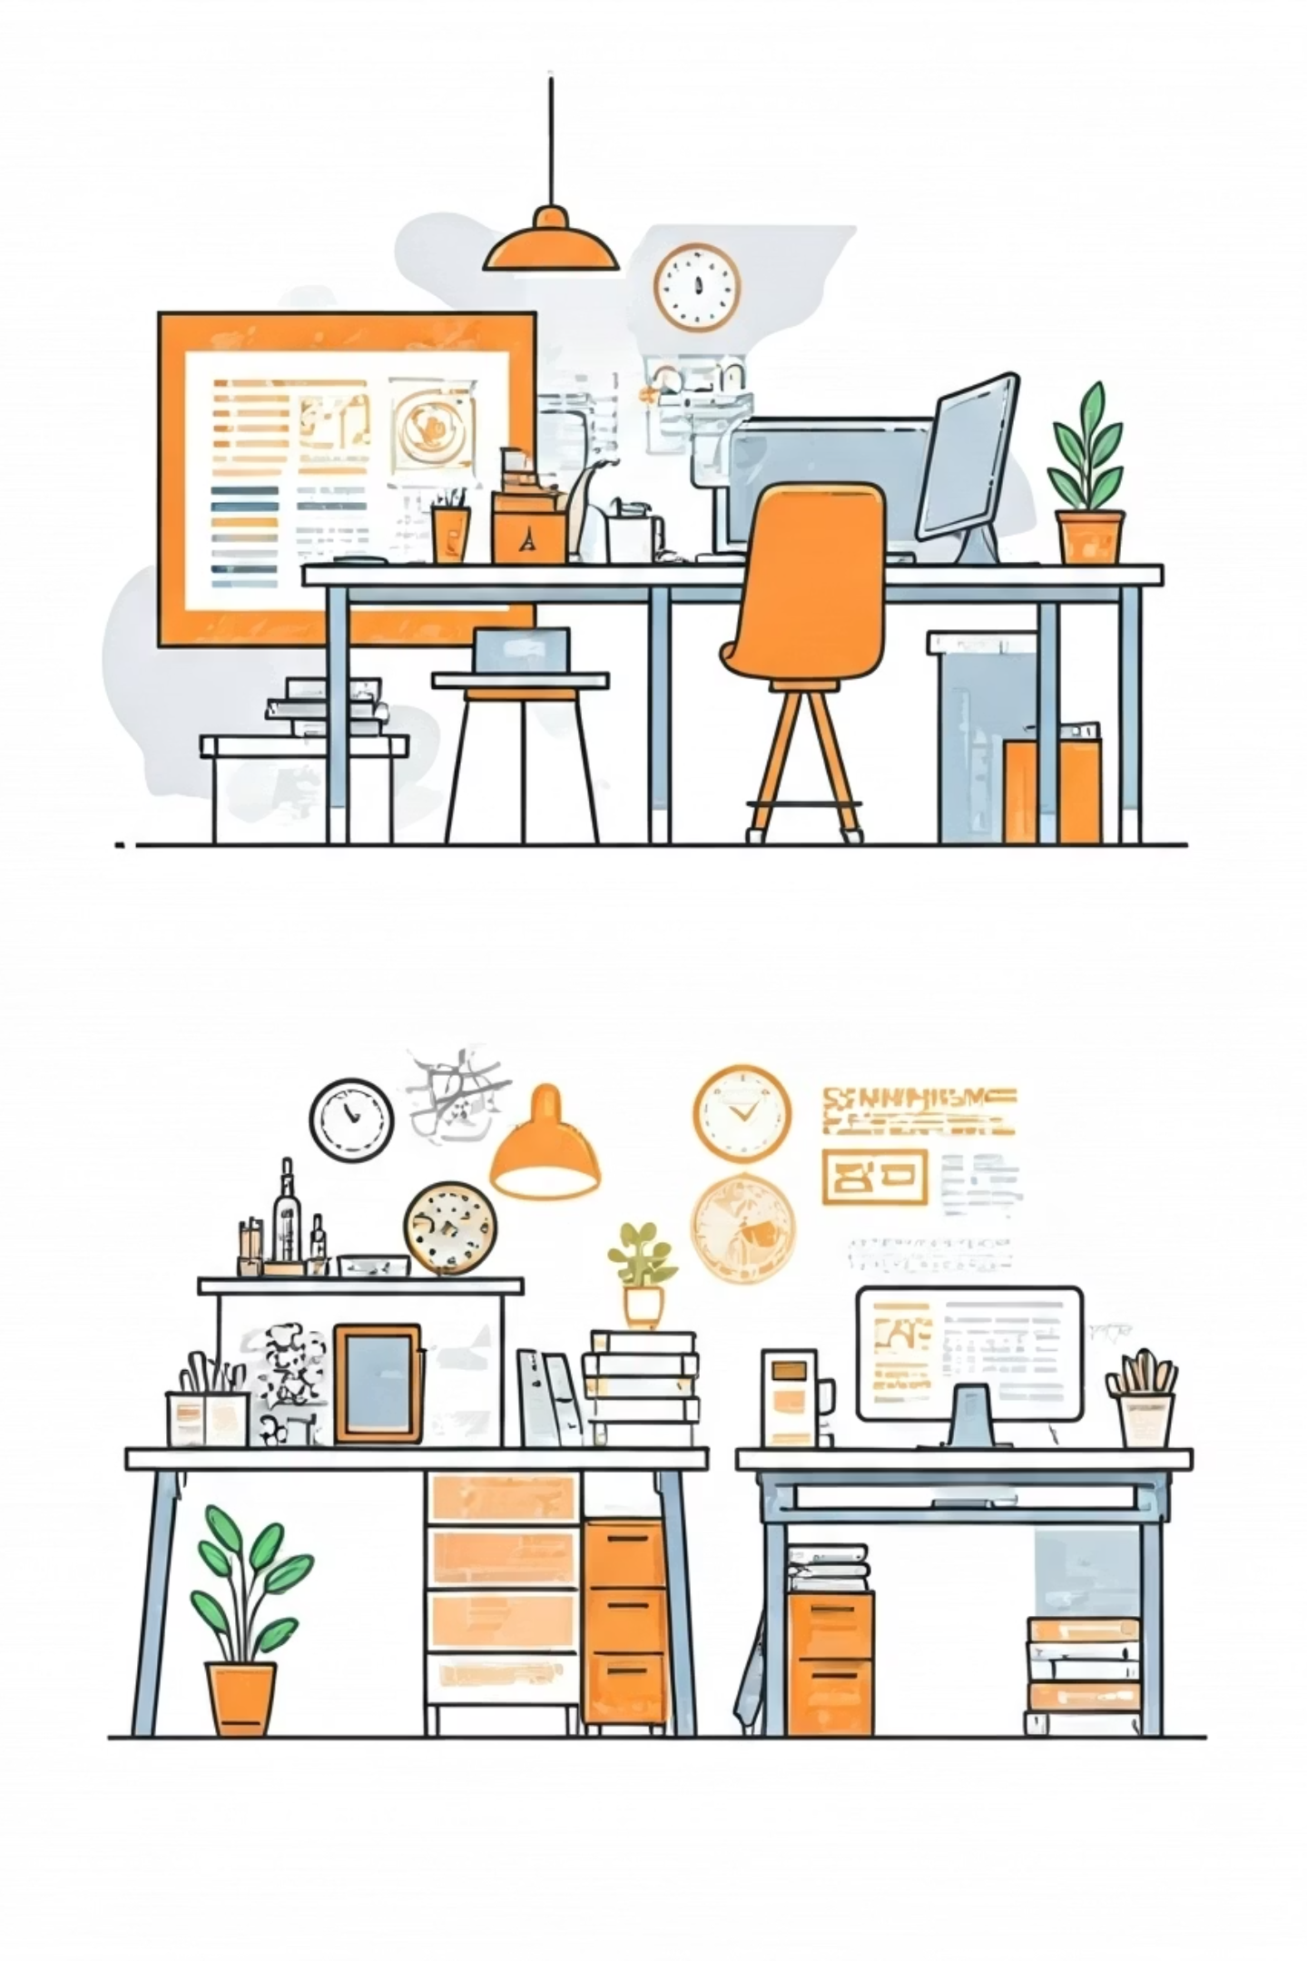
Subcultures in Organizations
Definition
Examples
Groups within organizations that develop distinct values, norms, or practices different from the dominant culture.
Marketing, production, or design departments forming their own work styles.
Impact
Positive → fosters belonging, creativity, innovation.
Negative → risk of countercultures, conflicts, or silos.

Slide 11

Culture as a Competitive Advantage
A strong, purpose-driven organizational culture is a powerful differentiator, setting companies apart in competitive markets.
This distinct culture offers numerous benefits:
Higher employee engagement and motivation.
Fostering innovation and creative problem-solving.
Increased talent retention and reduced turnover.
Enhanced customer loyalty and brand advocacy.
Leading examples include companies like Zappos and Southwest Airlines, renowned for their distinctive and impactful cultures.

Slide 12



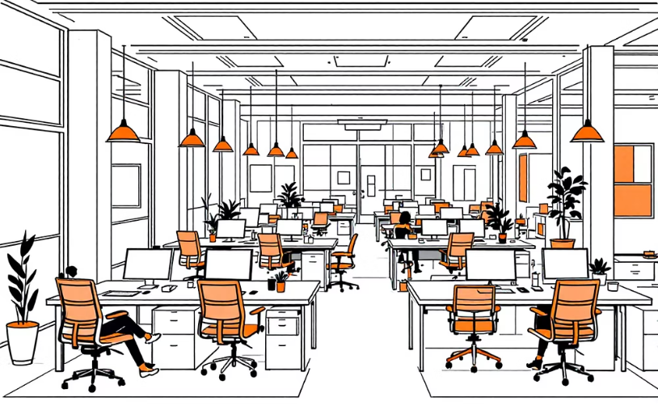
Types of Organizational Culture
The Competing Values Framework categorizes organizational cultures into four primary types, each with distinct characteristics and leadership styles that shape an organization's internal workings and external interactions.
Clan Culture
Adhocracy Culture
Market Culture
Hierarchy Culture
Characterized by a collaborative, family-like environment. Emphasizes loyalty, tradition, and extensive teamwork. Leaders act as mentors and facilitators.
Dynamic, entrepreneurial, and innovative. Focused on risk-taking, creativity, and adaptability to external changes. Leaders are visionaries and innovators.
Results-focused and highly competitive. Prioritizes achieving measurable goals, market share, and customer orientation. Leaders are tough and demanding competitors.
Structured and formalized with a clear chain of command. Values stability, efficiency, and adherence to rules and procedures. Leaders are coordinators and monitors.
Example: SAS Institute
Example: Tech startups
Example: Car dealerships
Example: Traditional companies

Slide 13
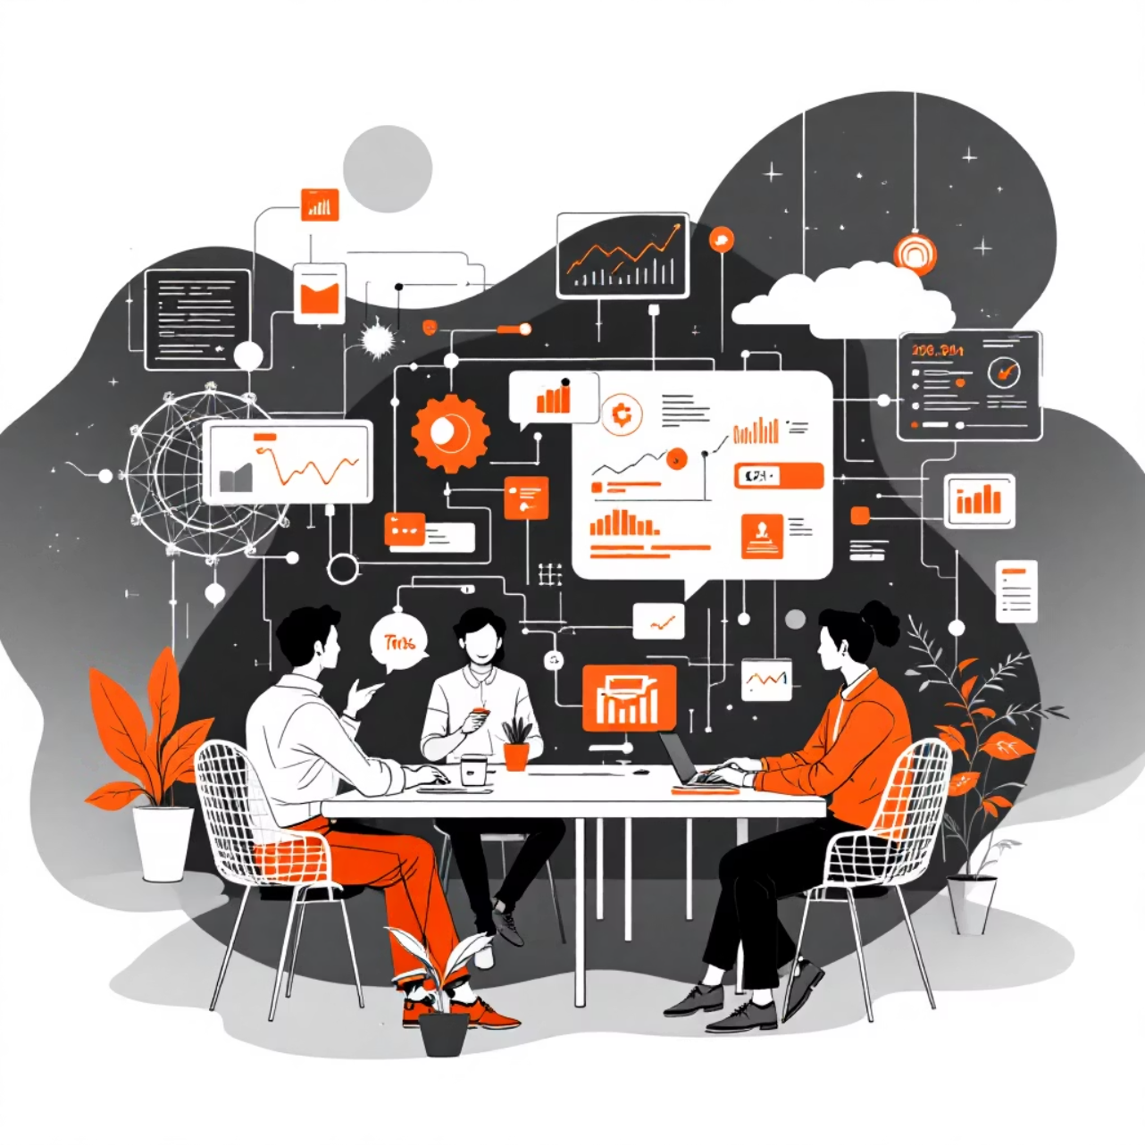
Digitalization and Organizational Culture
Digitalization profoundly reshapes organizational culture by introducing new norms and fostering dynamic collaboration. This technological shift encourages cultures that are agile, innovative, and transparent, adapting rapidly to new demands.
Key Cultural Dimensions Impacted:
Innovation & risk-taking
Collaboration & transparency
Adaptability & change readiness
Customer-centricity

Slide 14
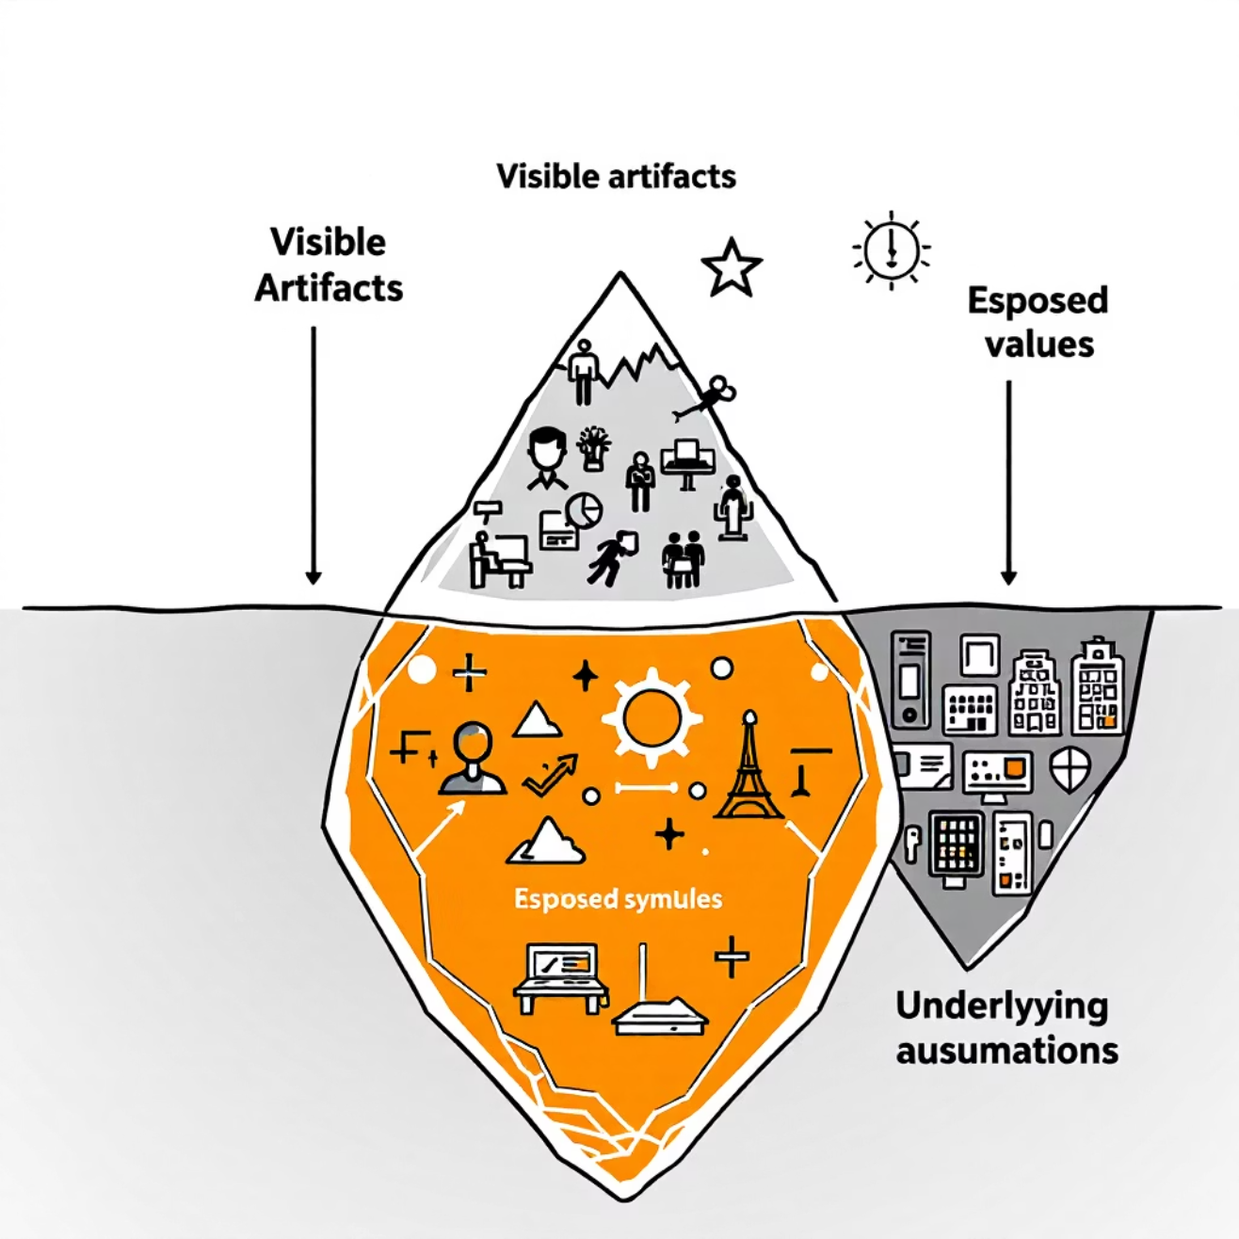
Theoretical Frameworks
Schein's Model of Organizational Culture
Edgar Schein's model describes organizational culture in three distinct levels, from the most visible to the deeply unconscious. Understanding these layers helps diagnose and influence cultural dynamics.
Artifacts: The visible and tangible aspects of culture, such as office design, dress codes, rituals, symbols, and language. These are easy to observe but hard to interpret without understanding the deeper levels.
Espoused Values: The strategies, goals, and philosophies explicitly stated by the organization. These are the "rules" and "principles" that guide behavior and decision-making, often found in mission statements or company policies.
Basic Underlying Assumptions: The deepest and often unconscious beliefs, perceptions, thoughts, and feelings that are taken for granted. These assumptions determine how group members perceive, think, and feel about things, and they are the ultimate source of values and actions.

Slide 15







Deal & Kennedy’s Model of Culture
Terrence Deal and Allan Kennedy identified six key elements that form the foundation of a strong organizational culture, emphasizing how these components shape behavior and identity.
History & Narratives
Shared past and collective stories that define identity.
Values & Beliefs
Core principles guiding behavior and decision-making.
Rituals & Ceremonies
Routine practices reinforcing company values.
Stories & Legends
Narratives of heroes, villains, and cultural norms.
Heroes & Role Models
Individuals embodying the company's ideals.
Cultural Network
Informal influencers who transmit cultural messages.

Slide 16




Cultivating Purpose-Driven Work Environments
Purpose-Driven Leadership
Leaders actively embody and communicate the organization's mission, inspiring teams to connect with the larger 'why'.
Transparent Communication
Aligning organizational purpose with employees' personal values fosters a more engaged and motivated workforce, enhancing productivity and job satisfaction.
Openly sharing company goals, progress, and challenges ensures everyone understands their role and contribution.
Celebrating Milestones
Recognizing and celebrating collective achievements reinforces shared values and motivates continued dedication.
Linking Daily Work to Vision
Help employees understand how their individual tasks directly contribute to the company's overarching purpose and impact.

Slide 17
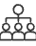
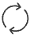


Collaboration and Teamwork Enhancement
A thriving culture of collaboration is essential for innovation and efficiency. By investing in skills development and implementing practical strategies, organizations can foster stronger, more cohesive teams.
Skills Development: Diversity
Skills Development: Rotating Roles
Embrace and leverage diverse perspectives and backgrounds to enrich problem-solving and creativity within teams.
Implement job rotation and cross-functional training to broaden employee skill sets and understanding of different team functions.
Skills Development: Cross-Training
Encourage team members to learn each other's responsibilities, building resilience and flexibility for project continuity.
Practical Tips for Effective Teamwork:
Open, transparent communication: Foster an environment where information flows freely and feedback is encouraged.
Build trust and accountability: Cultivate psychological safety where team members feel safe to take risks and are held responsible for their commitments.
Shared, clear goals: Ensure all team members understand the collective objectives and their individual contribution to achieving them.

